Slide 1
Intro to Async on ASP.NET
MIGANG 2015
Notes:
Questions welcome!

Slide 2
Who is this guy?

Slide 3


Slide 4
Asynchronous Requests
Notes:
This talk is about how async/await works on the server side.
The first section is about how asynchronous requests work, why we might want them, and what they are not capable of.

Slide 5
Benefits of Asynchronicity
On the client, the primary benefit is responsiveness.
Keeping the UI thread free.
Most async/await resources assume client-side.
On the server, the primary benefit is scalability.
“10x to 100x” scalability improvement.
Handles bursting traffic.
Asynchronicity drives the scalability of Node.js as well.
Notes:
On the Internet, most “async” resources assume a client-side application: Windows Store or Desktop.
Many developers aren’t aware that “async” is useful on the server side as well.
To understand why async helps severs scale, we’ll compare synchronous and asynchronous requests.

Slide 6
Synchronous Requests
Waiting
Waiting
Waiting
Waiting
Notes:
One thread per request – a common approach in simple ASP.NET apps.
There’s a thread pool (ha, ha) on the left, and requests come in on the right.
[CLICK] The first request comes in.
[CLICK] A thread pool thread is dispatched to handle the request, blocking the thread.
[CLICK] The request will wait for an external resource. While waiting, the thread is still blocked.
[CLICK] Eventually, the external call will complete, and the request resumes executing (still on the same thread).
[CLICK] When the request completes, the thread is freed and returned to the thread pool.
[CLICK] This gets interesting when you have more requests than threads.
[CLICK] All existing threads are assigned to requests.
[CLICK] These requests also wait for external resources, blocking those threads.
The third request has to wait for a free thread before it can start. It is in danger of a 503.
In this situation, the threads are blocked but are not doing anything useful.

Slide 7
Asynchronous Requests
Waiting
Waiting
Waiting
Waiting
Notes:
Now let’s look at how asynchronous requests are handled.
[CLICK] When a request comes in, a thread pool thread is assigned and blocks working on that request.
[CLICK] When the request waits on an external resource, the thread is immediately freed back to the thread pool.
While the thread is in the thread pool, it does not have a request context.
[CLICK] Eventually, the external call completes, and the request is ready to resume.
[CLICK] A thread pool thread is assigned to the request, and continues working on it.
This can be any thread pool thread, not the same thread.
When a thread resumes a request, it enters the request context.
[CLICK] When the request completes, the thread is returned to the thread pool.
[CLICK] Now, when there are more requests than threads…
[CLICK] Available threads are assigned to those requests.
[CLICK] As soon as the requests wait on external resources, their threads are freed to work on other requests or to return to the thread pool.
So we see that asynchronous requests allow a smaller number of threads to handle a larger number of requests.

Slide 8
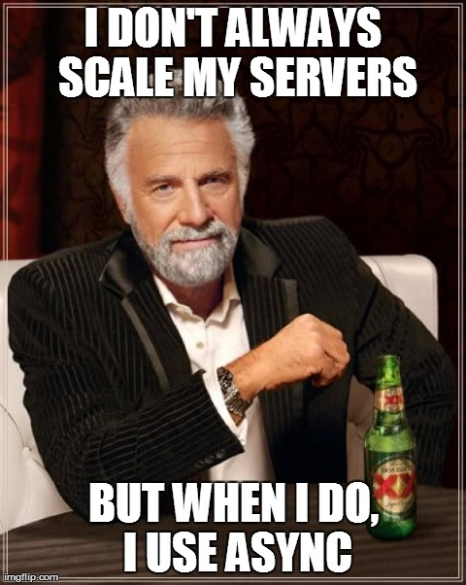
The Question
The question that is always asked:
Why not just increase the threadpool?
Notes:
Requests scale much better than blocking threads.
Async scales further than blocking threads.
Threads have ~1MB stack, plus kernel stack (unpageable).
Async scales faster than blocking threads.
ThreadPool has a limited injection rate (1 every 2 seconds currently) to avoid constant thread creation/destruction.
Async lets you use your memory (e.g., for caching) until you need to handle lots of requests.
Async does not replace the threadpool; rather, it ensures your code is making optimum use of the threadpool. (up to 11)
DEMO

Slide 9
Asynchronous != Parallel
Concurrent
Dataflow
Reactive
Multithreaded
Rx
Task.Run
Asynchronous
Parallel
Async/Await
PLINQ, Parallel
Notes:
This slide is mostly about terminology, and there’s no definite standard or consensus yet.
I prefer to use the term “concurrency” for multiple things happening at the same time.
Multithreading is one way to get concurrency; e.g., ASP.NET will handle multiple requests on different threads by default.
“Parallelism” is parallel processing, one type of multithreading. E.g., Parallel LINQ and the Parallel Task Library.
Asynchronicity is a way to get concurrency without multithreading. “There is no thread”.
Multithreading and Parallelism are colored red because you usually don’t want them on ASP.NET.

Slide 10
Why Didn’t We Have Async Already?
Asynchronous handlers and modules (.NET 1.1)
Asynchronous Web Pages (.NET 2.0)
Similar for ASP.NET MVC 2 (AsyncController).
Awkward
Task-based Asynchronous Pattern (.NET 4.5) – async, await
Asynchronous code is now maintainable.
Supported by ASP.NET MVC, Web Pages, WebAPI, SignalR, handlers, modules…
Notes:
Asynchronous request handlers are so good for scalability that they’ve actually been supported since .NET 1.1.
But up until recently, asynchronous code has always been awkward.
What async/await bring to the table is maintainable asynchronous code.

Slide 11
A (Brief) History of Asynchronous ASP.NET
APM – Asynchronous Programming Model
Begin*/End*, IAsyncResult
Awkward code but has the widest support. .NET 1.1 (2003).
EAP – Event-based Asynchronous Pattern
*Async/*Completed, AsyncCompletedEventArgs
Slightly less awkward. .NET 2.0 (2005).
TAP – Task-based Asynchronous Pattern
*Async, Task
Natural code. .NET 4.5 (2012).
HttpWebRequest
WebClient
HttpClient
Notes:
Asynchronous request handlers are so good for scalability that they’ve actually been supported since .NET 1.1.
Support for asynchronous pages was added in .NET 2.0.
But up until recently, asynchronous code has always been awkward.
What async/await bring to the table is maintainable asynchronous code.
We are focusing on TAP in this talk, but there are still parts of ASP.NET that use these older patterns. TAP interoperates cleanly with APM.

Slide 12
What about Node.js?
Asynchronicity
Node is asynchronously single-threaded. Load-balancing, etc.
ASP.NET is asynchronously multithreaded.
Language: JavaScript everywhere
.NET async/await enables maintainable asynchronous code.
JS currently has callbacks (+promises). Code is still awkward.
ES6 introduced generators which (with promises) is a step in the right direction.
ES7 will introduce async/await.
Notes:
Except for these differences, async in Node.js and async on ASP.NET are very similar.

Slide 13
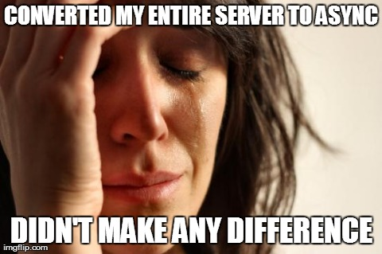
What Asynchronicity Doesn’t Do
Async does not change HTTP.
When the thread returns to the pool, the response is not yet sent.
One request, one response.
Still need WebAPI/SignalR/AJAX/UpdatePanel.

Slide 14
What Asynchronicity Doesn’t Do
Async does not scale out.
Async helps scale up.
Still should design for scale out:
Stateless, idempotent requests.
Reliable queueing.
Notes:
“Scale up” on this slide really means “take full advantage of your server resources”.
Async does help you so you don’t have to scale out as often, but you should still design for scale out.

Slide 15
What Asynchronicity Doesn’t Do
Async is bad for CPU-bound tasks.
Async excels at I/O.
CPU work always requires a thread.
“Fake” asynchronicity (pushing work to background threads) actually hurts scalability.

Slide 16
What Asynchronicity Doesn’t Do
Async won’t help with a single DB backend.
DB is scalability bottleneck.
“Should my database calls be Asynchronous?” http://blogs.msdn.com/b/rickandy/archive/2009/11/14/should-my-database-calls-be-asynchronous.aspx
Async good for: DB cluster, Azure storage, web APIs.
Notes:
If all your requests hit the DB, and it’s just a single DB machine…

Slide 17
Async and Await
Notes:
We’ve covered asynchronous requests in general.
Now we’ll look at the new async and await keywords specifically.

Slide 18
Introduction to Async
async Task DoNothingAsync()
{
// In the Real World, we would actually do something...
await Task.Delay(100);
}
Notes:
Let’s dive right in. This is the real syntax for the async and await keywords.

Slide 19
Introduction to Async
async Task DoNothingAsync()
{
// In the Real World, we would actually do something...
await Task.Delay(100);
}
The async keyword:
Enables the await keyword for that method.
Transforms the method into a state machine, very similar to the yield keyword.
That’s it.
Notes:
The async keyword can only be applied to a method.
Details of the transformation are not important; just be aware that there is a transformation going on.
An async method does not mean it runs on a thread pool thread.
When you call an async method, it starts executing synchronously.

Slide 20
Introduction to Async
async Task DoNothingAsync()
{
// In the Real World, we would actually do something...
await Task.Delay(100);
}
async Task DoNothingAsync()
{
Task delay = Task.Delay(100);
await delay;
}
await
Takes a single argument.
“Awaitable”
Usually a Task or Task<T>.
Notes:
“Await” is like a unary operator; it takes a single argument (like a cast).
This argument is an “awaitable”. I won’t get into the specifics, but an “awaitable” is a type that matches a certain pattern (similar to how foreach works).
An “awaitable” represents an asynchronous operation. In this talk, all our “awaitables” are Task objects.
Technically, you don’t “await” a method; you call the method and then “await” the Task it returns. But “await a method” and “awaitable method” are common phrases.
- Another method can await the task returned from DoNothingAsync, not b/c the method is async, but b/c it returns a Task.
Async methods start synchronously; so this method will (synchronously) call Task.Delay and then await.
Await is where things can start to get asynchronous.

Slide 21
Introduction to Async
async Task DoNothingAsync()
{
// In the Real World, we would actually do something...
await Task.Delay(100);
}
await behavior:
If awaitable (task) is complete, continues synchronously.
Otherwise:
Pauses the method and registers it with the awaitable.
Then returns.
Notes:
The “registering” is saying, “when you complete, please resume this method”.
When DoNothingAsync returns, it returns an incomplete Task.
The returned Task represents this method; when this method completes, it will complete the Task.

Slide 22
Introduction to Async
async Task DoNothingAsync()
{
// In the Real World, we would actually do something...
await Task.Delay(100);
}
Pausing and Resuming (when awaiting tasks)
A “context” is captured and used to resume.
“await” = “asynchronous wait”
Thread is not blocked (asynchronous).
Method is paused (waits).
Notes:
In ASP.NET the “context” is the request context (HttpContext.Current, identity, and culture).
In this example, if you have the request context before the await, then you’ll have it after the await.
Request context only allows one thread at a time.
Technically: SynchronizationContext.Current or TaskScheduler.Current.

Slide 23
Introduction to Async
Return types for async methods: Task or Task<T> (or void)
Avoid async void.
async Task<int> DoNothingAsync()
{
await Task.Delay(100);
return 42;
}
async Task DoNothingAsync()
{
await Task.Delay(100);
}
Notes:
An async method may return Task or Task<T> (or void).
Use async Task if you have nothing to return.
Use async Task<T> if you have a return value.
- Note that the return type is int while the method return type is Task<int>. You don’t return a task object directly if the method is marked async.
Avoid async void.

Slide 24
Introduction to Async
Follow the Task-based Asynchronous Pattern (TAP):
http://msdn.microsoft.com/en-us/library/hh873175.aspx
Naming: MyMethodAsync
Cancellation:
Take a CancellationToken parameter.
Pass the token through to other methods.

Slide 25
Async/await on ASP.NET

Slide 26

ASP.NET Requirements and Settings
.NET 4.5 is required.
Microsoft.Bcl.Async enables async/await on .NET 4.0 desktop/SL/WP/WS. It will install without warnings in ASP.NET 4.0 but will not work correctly.
Be sure to target .NET 4.5 or at least turn off SyncCtx “quirk”.
Particularly a problem when upgrading an existing project to 4.5.
httpRuntime[@targetFramework=“4.5”]
appSettings/add[@key=“aspnet:UseTaskFriendlySynchronizationContext”, @value=“true”]
http://blogs.msdn.com/b/webdev/archive/2012/11/19/all-about-httpruntime-targetframework.aspx

Slide 27
Other Useful Settings
IIS/HTTP.sys has default queue limit of 1,000.
At least 5,000 is recommended for async.
Application Pools -> Advanced Settings -> Queue Length
ServicePointManager.DefaultConnectionLimit
Notes:
DefaultConnectionLimit default = 12 * cores

Slide 28
Aborting ASP.NET Requests
Sync would Thread.Abort on timeout & ignore disconnect.
HttpRequest.TimedOutToken - async timeout.
httpRuntime[@executionTimeout]
HttpResponse.ClientDisconnectedToken - async disconnect.
Do not use for now. http://forums.asp.net/post/5339766.aspx
Newer frameworks pass you a CancellationToken directly.
Notes:
Aborting is more important as our apps become more dependent on services (e.g., Azure retries with exponential backoff).
WebAPI/MVC/SignalR all pass you a CancellationToken directly and you don’t need to use these.

Slide 29
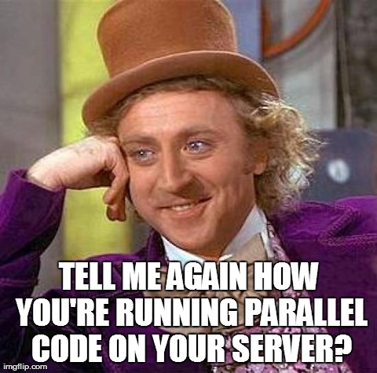
Parallelism and Background Threads
Parallel server code is almost always a bad idea (though it can be useful in controlled environments - known # of users).
Avoid: Parallel/PLINQ, Task.Run, TaskFactory.StartNew, Task.ContinueWith.
Beware: Fake asynchronous methods (e.g. file streams).
Notes:
http://blogs.msdn.com/b/pfxteam/archive/2010/02/08/9960003.aspx
Concurrency is OK! It’s encouraged! But parallelism not so much.
Parallel code will use multiple threads per request instead of one thread handling multiple requests.
Parallelism cannot use SynchronizationContext, so you can’t use HttpContext.Current or Culture settings.

Slide 30
Fake Asynchronous Methods
Waiting
async Task SaveAsync()
{
await myStream.WriteAllBytesAsync();
await myStream.FlushAsync();
}
Notes:
Fake asynchronous methods consume a thread pool thread so they appear asynchronous. In this example, our methods are assuming that the async stream methods are actually async, but they’re not; internally, they’re queueing synchronous work to the thread pool (e.g., Task.Run).
This means extra thread swapping (inefficient) and using a thread for the entire request (kills scalability).
At no point does this request have all its threads free! It is always using at least one thread.

Slide 31
Gotchas

Slide 32
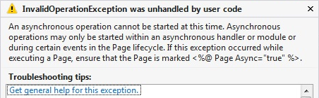
ASP.NET SynchronizationContext
Async void and EAP methods notify SyncCtx of operations.
http://msdn.microsoft.com/en-us/magazine/gg598924.aspx
ASP.NET will catch improper use of SyncCtx and throw:
Do NOT mess with the aspnet:AllowAsyncDuringSyncStages appSetting.
Notes:
EAP = Event-based Asynchronous Programming.
Replace WebClient (EAP) with HttpClient (TAP).
EAP works fine on ASP.NET if the handler is asynchronous.
ASP.NET vNext does not have a SynchronizationContext at all. ☺

Slide 33

Thread-Local State
Remove:
[ThreadStatic]
ThreadLocal<T>
Thread data slots
CallContext.[Get|Set]Data
Replace with:
AsyncLocal<T> (.NET 4.6)
HttpContext.Current.Items (if you must)
CallContext.Logical[Get|Set]Data (.NET 4.5)
Notes:
Items is not portable; will be going away in ASP.NET vNext.
AsyncLocal and logical call context should only store immutable data. Microsoft.Bcl.Immutable.

Slide 34

Returning Early
This is not you.
Notes:
Your situation is not unique.
Your company is not a precious little snowflake.

Slide 35

Returning Early
Correct solution:
Persistent storage (Azure queue, MSMQ, WebSphere MQ, etc.).
Processing backend (Azure worker role, Win32 service, etc.).
Completion notification (Azure message bus, SignalR, AJAX polling, etc.).
Incorrect solutions:
Task.Run, Task.ContinueWith, TaskFactory.StartNew.
But if you must:
HostingEnvironment.QueueBackgroundWorkItem (.NET 4.5.1)
AspNetBackgroundTasks (Nuget)
Notes:
The “just ok” soltuions will track async/sync tasks executing outside the request context and notify ASP.NET that they’re running. Also publishes a CancellationToken which is set when ASP.NET has requested the AppDomain to exit.
But don’t use this unless you are perfectly fine with the task never being executed!

Slide 36
Main Loop
Nito.AsyncEx – NuGet library by yours truly.
General-purpose async/await helpers.
Nito.AsyncEx.AsyncContext.Run(delegate).
Win32 services, Azure worker roles.
Single-threaded context for async/await.
Similar architecture to Node.js.
Notes:
Not an ideal solution for a multi-core server.

Slide 37
Framework/Library Support
Notes:
Existing frameworks (and libraries) have very strong backwards-compatibility requirements that can make new features like async/await a bit awkward or unusable in some scenarios.

Slide 38
Newer Development: Full Async Support
WebApi:
Async controllers.
Entire pipeline is async (async filters, handlers, etc).
SignalR:
Full support for async.

Slide 39
Newer Development: Full Async Support
Entity Framework 6+ (EntityFramework)
Don’t use lazy loading in async code!
HttpClient (Microsoft.Net.Http)
Azure Storage Client Library 2.1+ (WindowsAzure.Storage)

Slide 40
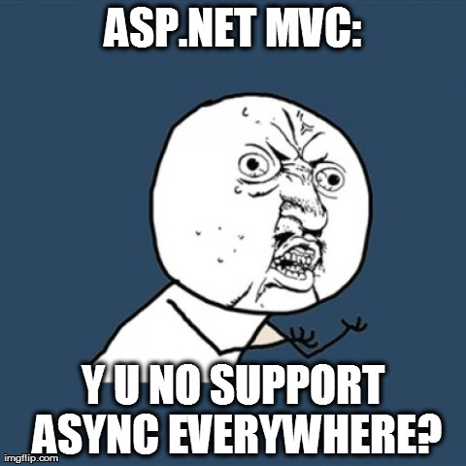
ASP.NET MVC: Partial Async Support
http://www.asp.net/mvc/tutorials/mvc-4/using-asynchronous-methods-in-aspnet-mvc-4
Supported:
Async controller actions.
Cancellation.
Not supported:
Async filters. https://aspnetwebstack.codeplex.com/workitem/1185
Async child actions. https://aspnetwebstack.codeplex.com/workitem/601

Slide 41
ASP.NET WebForms
http://www.asp.net/web-forms/tutorials/aspnet-45/using-asynchronous-methods-in-aspnet-45
Page.Async
Async support is “opt-in”.
Page.RegisterAsyncTask / PageAsyncTask
ASP.NET team prefers these over async void event handlers.
Page.AsyncTimeout
Timeout for the CancellationToken passed to the PageAsyncTask delegate.

Slide 42
ASP.NET
Http Handlers: HttpTaskAsyncHandler
http://www.asp.net/aspnet/overview/aspnet-and-visual-studio-2012/whats-new#_Toc318097378
Http Modules:
http://www.asp.net/aspnet/overview/aspnet-and-visual-studio-2012/whats-new#_Toc318097377
Wrap async handler in EventHandlerTaskAsyncHelper.
That wrapper exposes BeginEventHandler and EndEventHandler properties, which you then pass to AddOnBeginRequestAsync from your Init method.
Wrapper translates TAP (async Task) to APM (Begin/End/IAsyncResult).

Slide 43
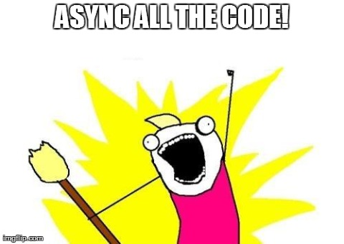
Q&A
Best Practices in Asynchronous Programming:
http://msdn.microsoft.com/en-us/magazine/jj991977.aspx
Notes:
Resources are available at StephenCleary.com - slides, example code, etc.

